Slide 1
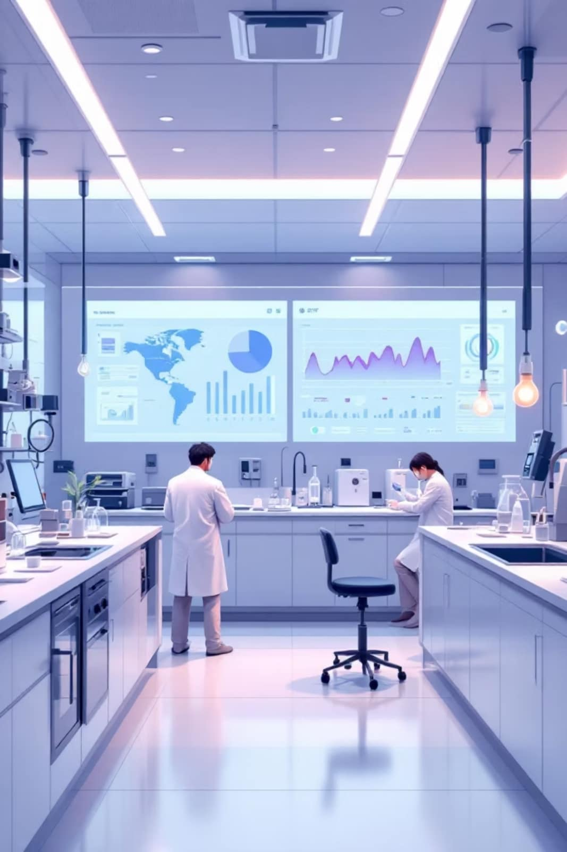

Green Lab
Smart Lab Monitoring & SDG System

Slide 2
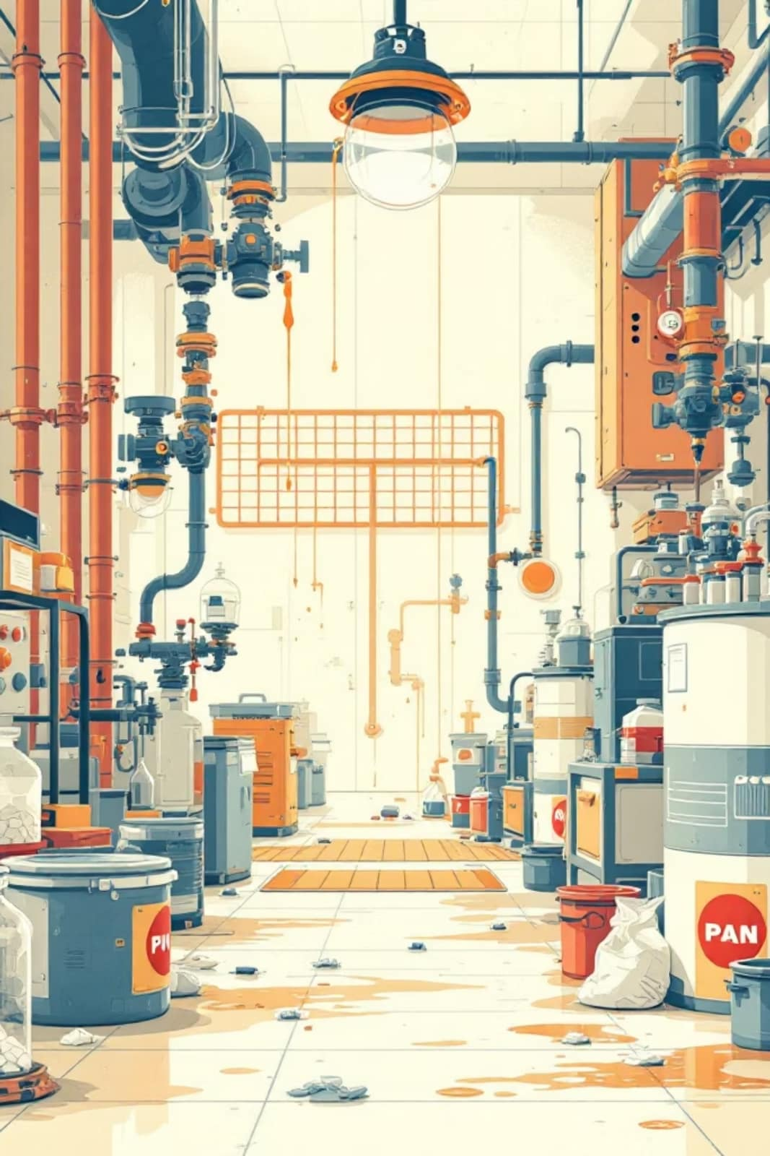
The Challenge: Unmonitored Lab Resources
Water Waste
No tracking of consumption or leak detection
Gas Hazards
Undetected leaks pose serious safety risks
Energy Loss
Excessive electricity usage goes unmonitored
No System
Administrators cannot track or control usage

Slide 3
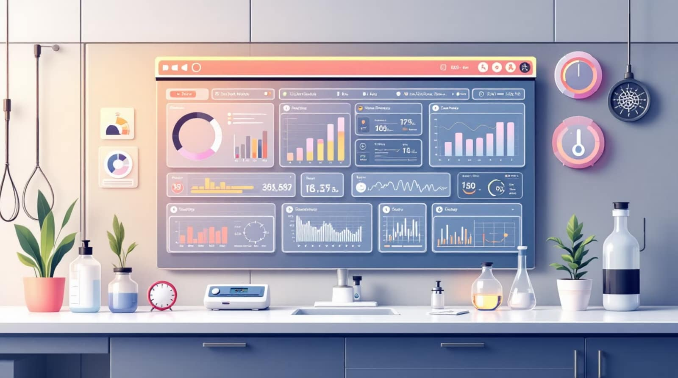
Our Solution: Web-Based Monitoring Platform
Real-Time Tracking
Monitor water, gas, and electricity usage across all labs from a centralized dashboard
Intelligent Alerts
Instant notifications for leaks, hazards, and unusual consumption patterns
Resource Requests
Streamlined system for requesting additional resources with admin approval workflow

Slide 4
Role-Based Access System
Administrator
Staff
Full control over all labs, user management, reports, and system settings
View lab data, request resources, and send emergency alerts for their assigned labsBasic monitoring access, submit small requests, and report issues or hazards

Slide 5
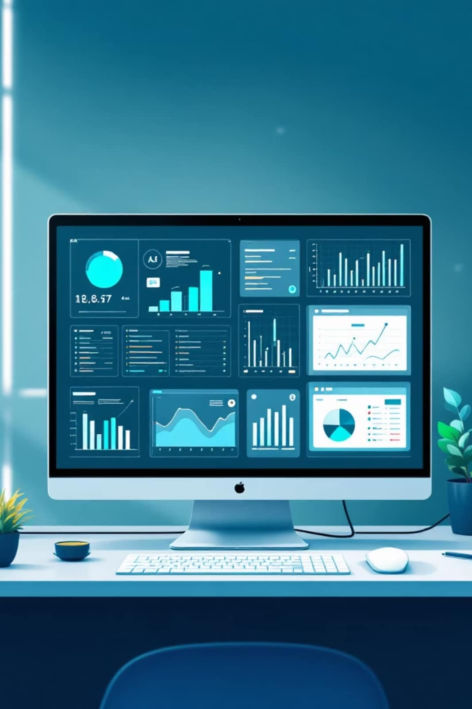
Administrator Dashboard
Monitor All Labs
View real-time data from every lab in the facility
Manage Alerts
Receive and respond to emergency notifications
Approve Requests
Review and authorize resource requests
Generate Reports
Export detailed usage analytics and trends

Slide 6

Staff Dashboard
View Lab Data
Request Resources
Monitor real-time consumption, environmental conditions, and resource status within assigned labs.
Easily submit requests for new equipment, chemical supplies, or maintenance services with an approval workflow.
Send Emergency Alerts
Trigger instant notifications to administrators for critical safety issues or urgent operational needs.

Slide 7
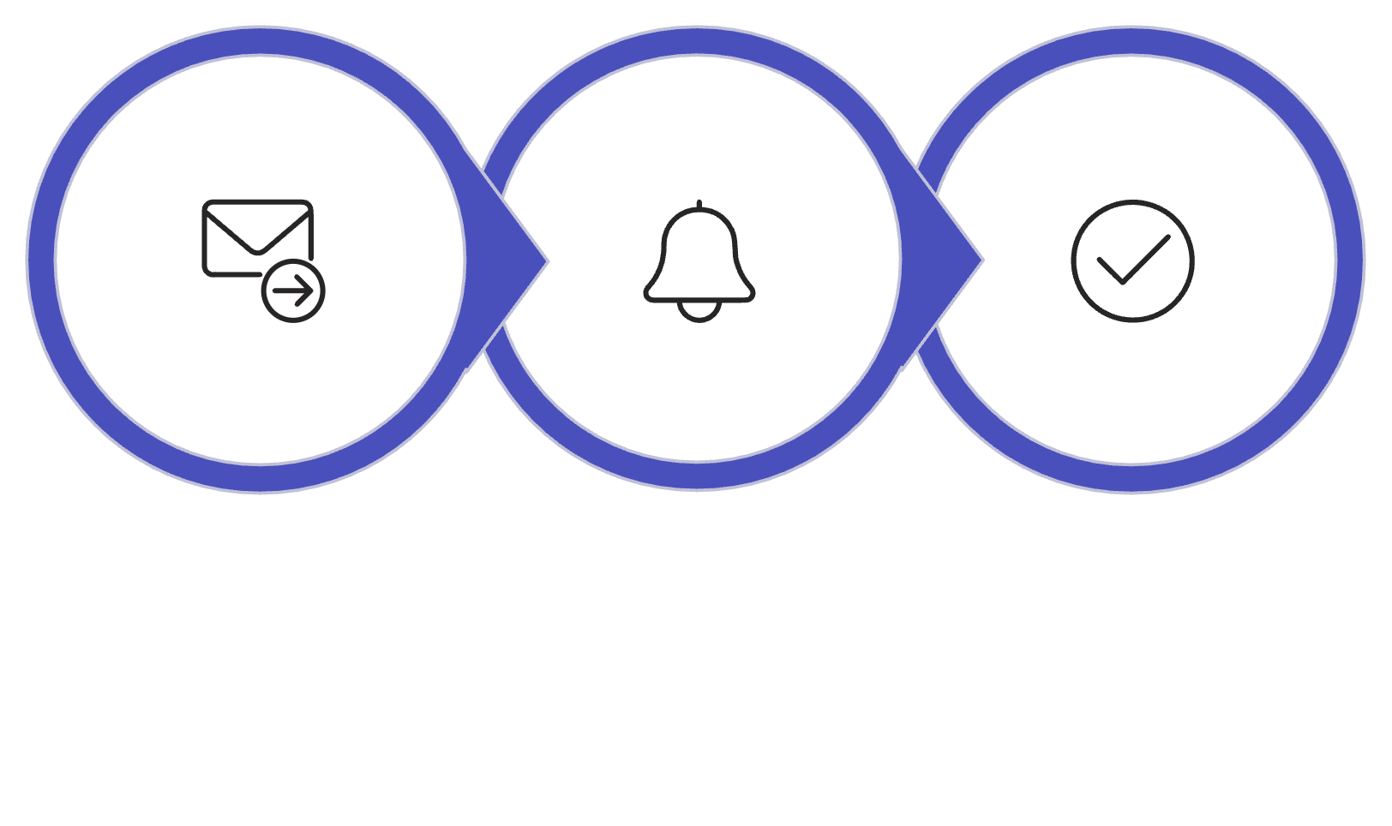
Resource Request & Emergency Systems
Resource Request Workflow
Emergency Alert System
Gas leak detection and immediate notification
Water leakage sensors trigger alerts
Electrical hazard monitoring
Real-time admin dashboard notifications
Priority escalation for critical issues
Submit Request
Admin Notified
Approve or Reject

Slide 8

Impact on Sustainable Development Goals
Our Green Lab solution goes beyond operational efficiency, making a tangible difference in achieving key Sustainable Development Goals through optimized resource management.
SDG 6: Clean Water
Our system tracks water usage, detects leaks, and prevents waste, directly contributing to water conservation.
SDG 7: Clean Energy
By monitoring electricity, we enable optimization, reduce consumption, and support clean energy goals.
SDG 12: Responsible Usage
Real-time data fosters conscious resource use and minimizes unnecessary waste, aligning with responsible consumption and production.
SDG 13: Climate Action
By saving energy and resources, we indirectly reduce carbon emissions, supporting global efforts against climate change.

Slide 9
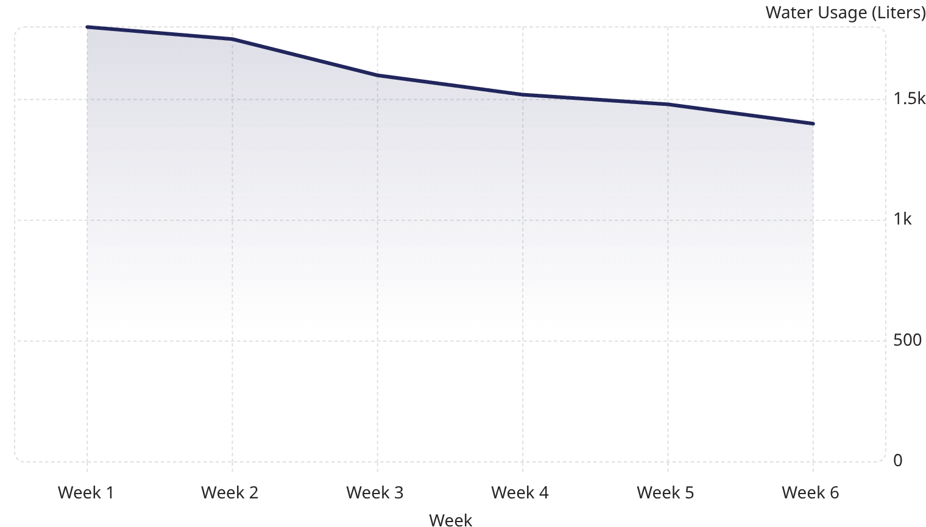
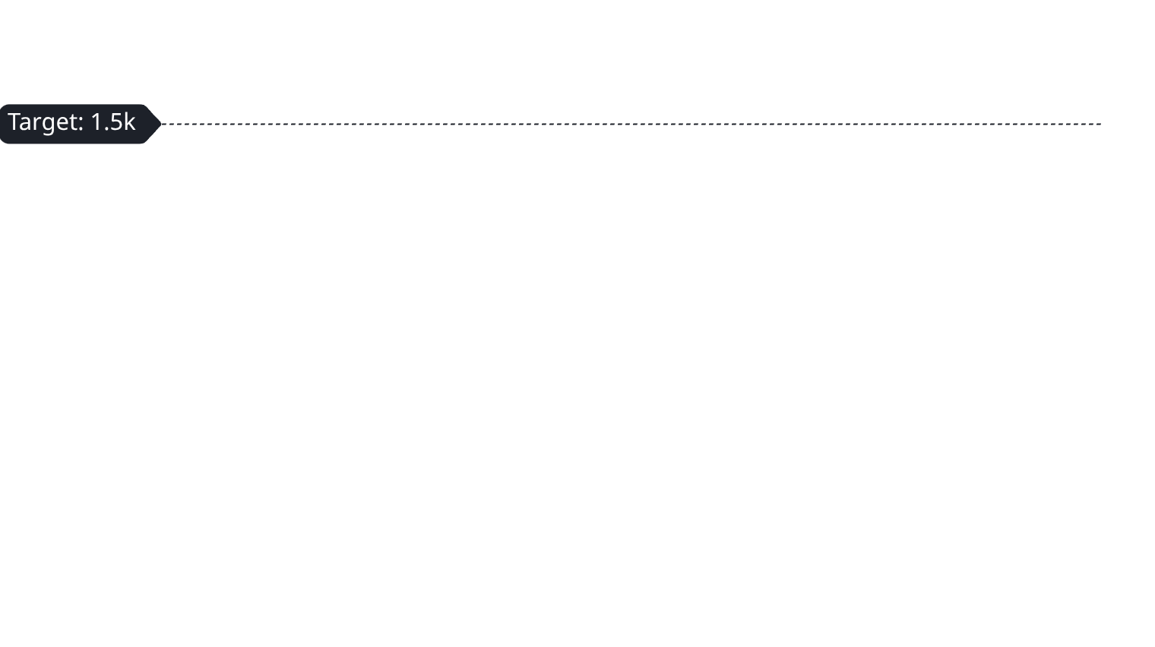
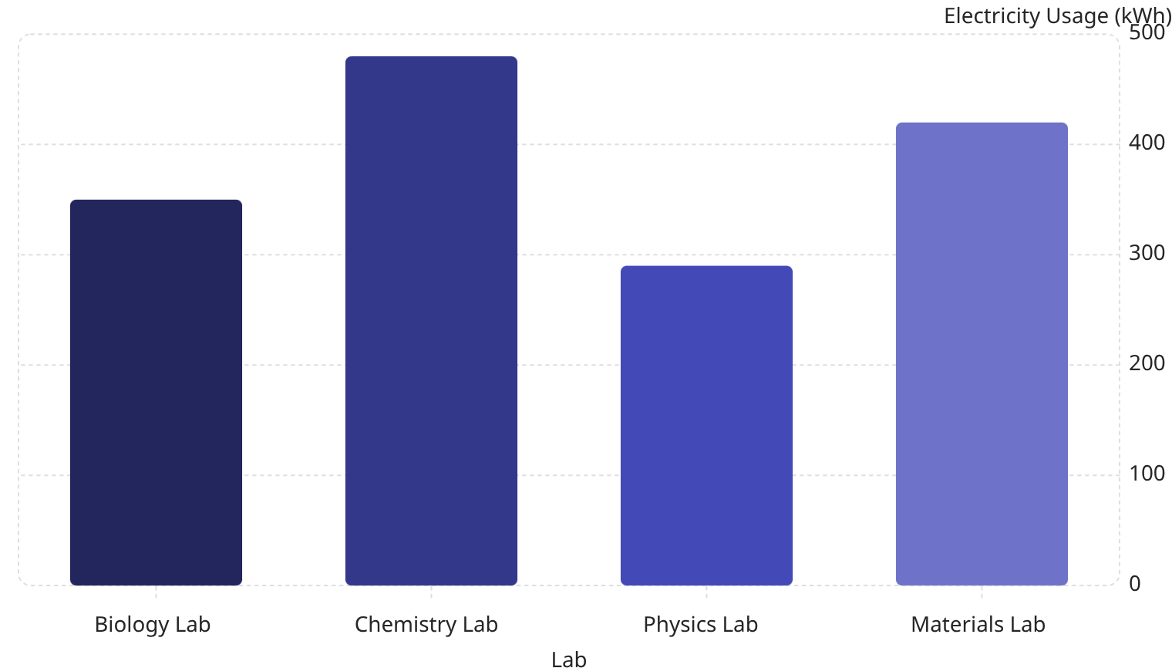
Dashboard & Analytics
Our comprehensive dashboard provides real-time data and historical insights into resource consumption, empowering administrators and faculty to make data-driven decisions for efficiency and sustainability.
This line graph illustrates a downward trend in water usage over six weeks, demonstrating the positive impact of monitoring and awareness. The dashboard highlights deviations from set targets, such as the initial weeks exceeding our 1500-liter goal.
480
420
350
290
The column chart above compares electricity consumption across different labs, revealing that the Chemistry Lab has the highest usage. This type of data helps identify areas for potential energy savings and targeted interventions.

Slide 10
Impact on Sustainable Development Goals
SDG 6: Clean Water
SDG 7: Clean Energy
Reduced water waste through leak detection and usage monitoring
Optimized electricity consumption and reduced carbon footprint
SDG 12: Responsible Consumption
SDG 13: Climate Action
Efficient resource management and waste reduction
Lower emissions through reduced resource waste

Slide 11
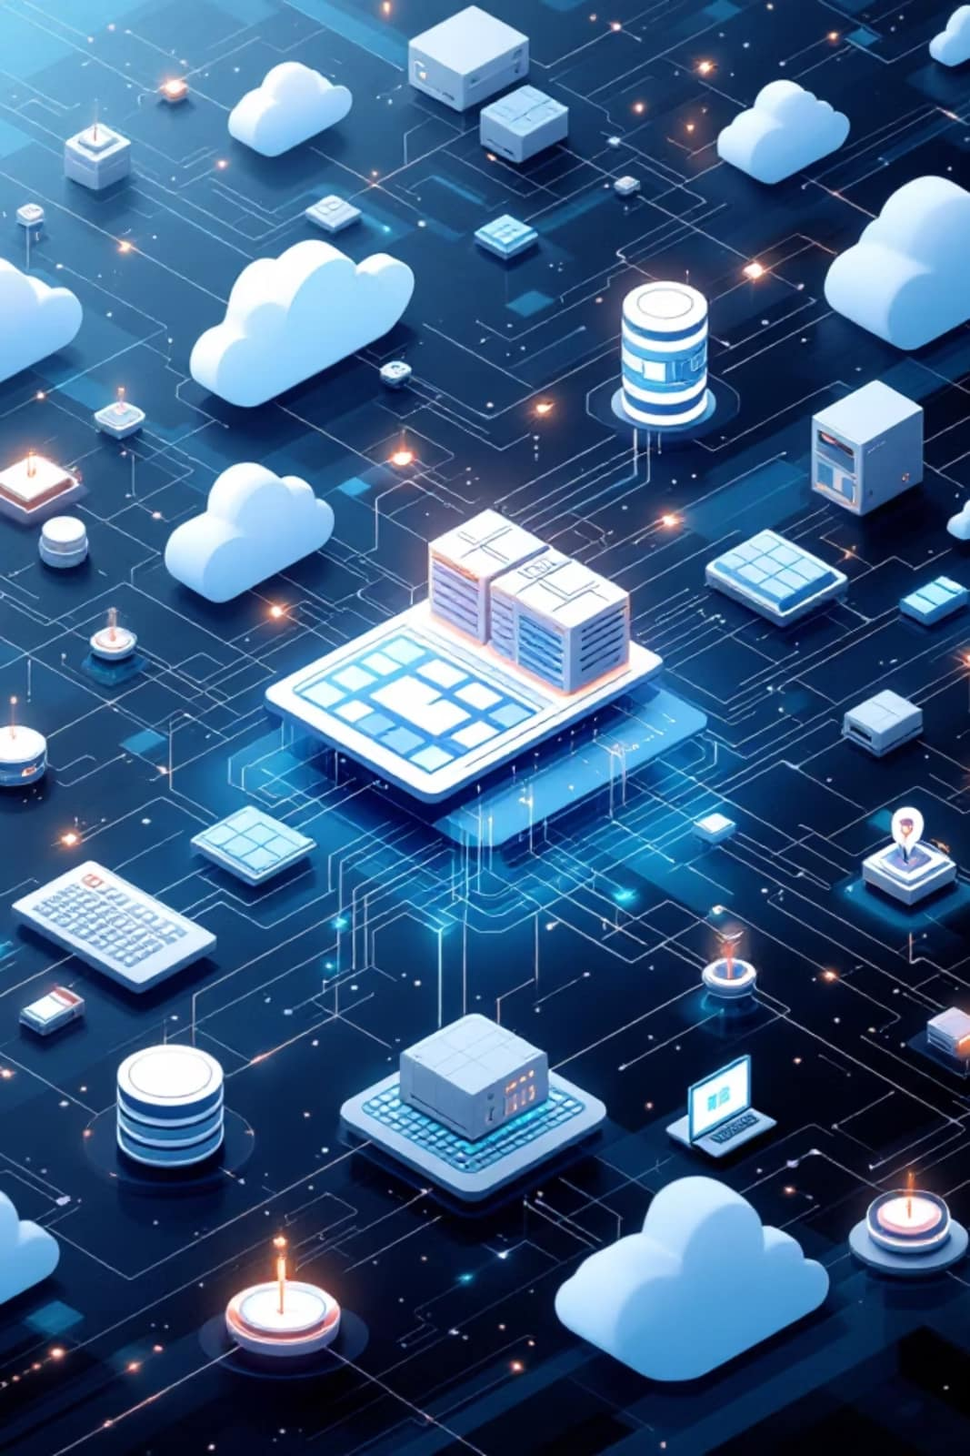
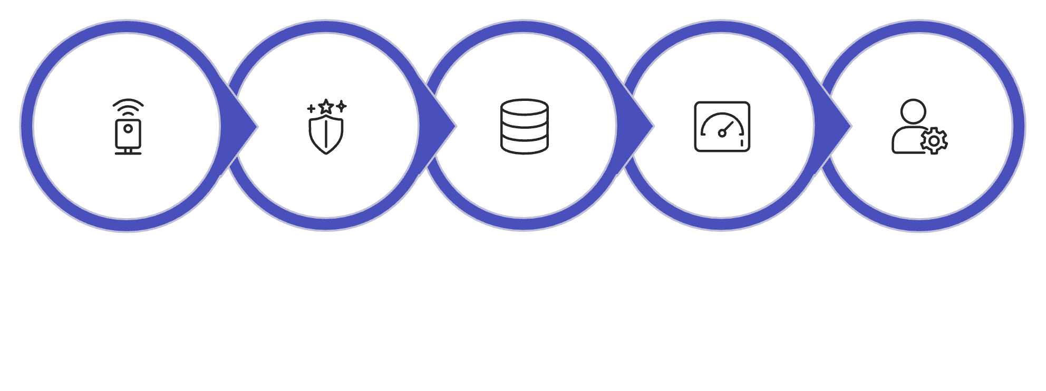
System Architecture
Our platform's robust architecture ensures seamless data flow, from initial collection to final presentation for administrative insights and control.
Sensors
Transmit
Database
Dashboard
Administrator
This structured approach guarantees reliability, scalability, and security across all monitoring and management functions, providing a comprehensive solution for smart lab operations.

Slide 12
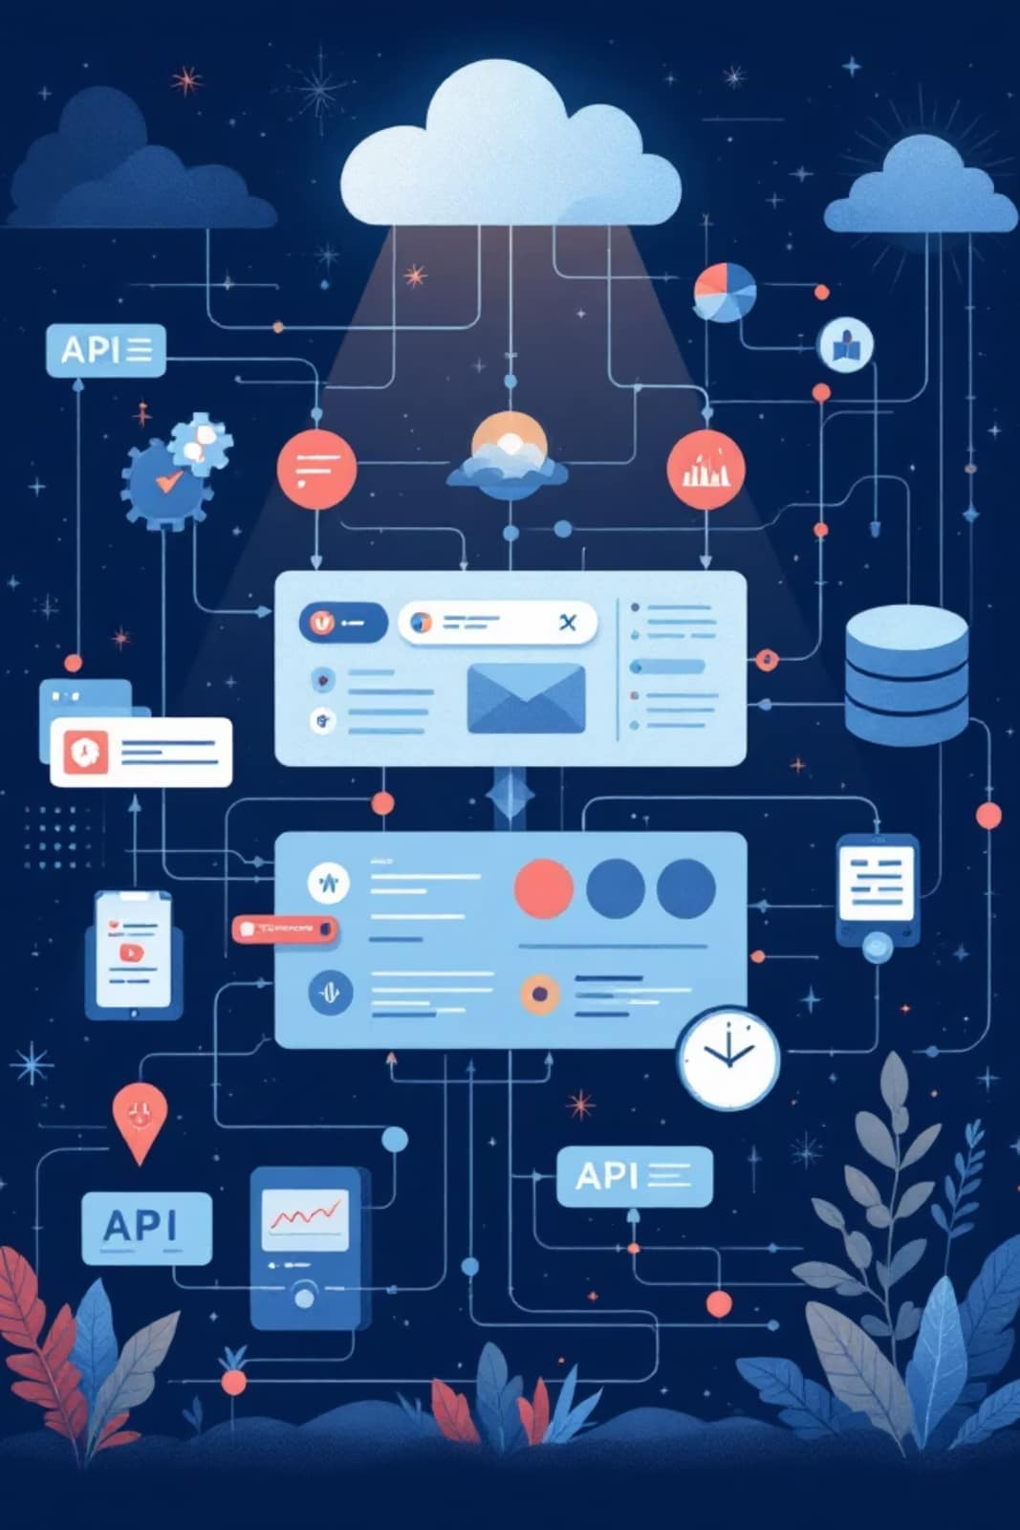
Our Technology Stack
Next.js
Supabase
React framework for building high-performance and scalable web applications.
Open-source backend platform providing database, authentication, and real-time APIs.
PostgreSQL Database
Charts
Reliable and robust relational database for secure storage of all lab data.
Interactive data visualizations for clear, real-time insights into resource consumption and trends.
API
Seamless integration ensuring smooth communication between all front-end and back-end components.

Slide 13
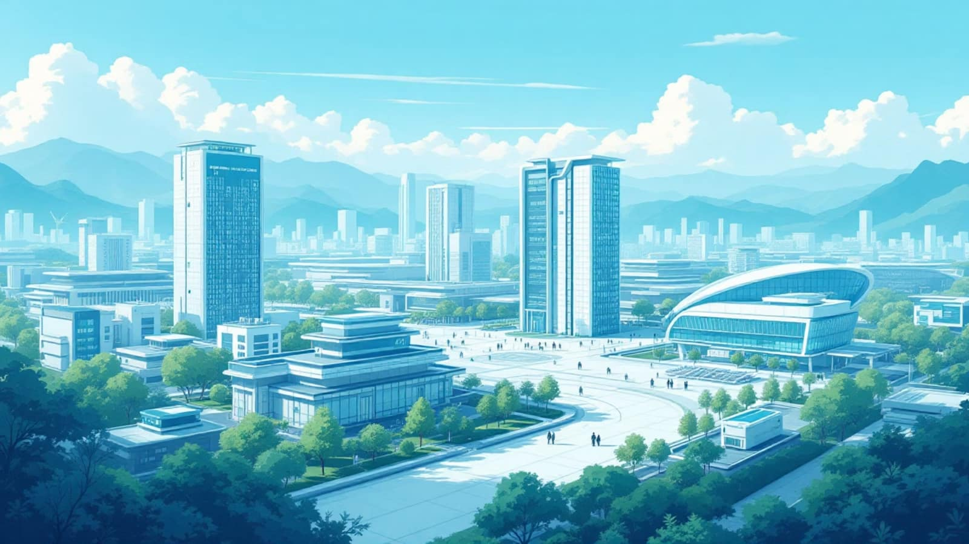
Future Vision
AI-Powered Predictions
Automated Shutoff Systems
Utilize advanced AI to forecast resource consumption, detect anomalies, and suggest optimizations for efficiency.
Implement intelligent auto-shutoff protocols for unused equipment or detected hazards, preventing waste and ensuring safety.
Dedicated Mobile App
Smart Campus Integration
Access real-time data, receive instant alerts, and manage resources conveniently from a user-friendly mobile application.
Seamlessly connect Green Lab data with wider campus infrastructure for holistic resource management and sustainability initiatives.

Slide 14

Conclusion: A Smarter, Greener Future
The Green Lab solution delivers comprehensive benefits that redefine laboratory management and contribute significantly to global sustainability efforts.
Improved Lab Safety
Enhanced safety protocols through real-time hazard detection and proactive alert systems for gases and leaks.
Reduced Waste & Consumption
Efficient resource management of water and electricity minimizes environmental impact and lowers operational costs.
Supports SDG Goals
Directly contributes to Sustainable Development Goals, fostering a culture of responsibility and environmental stewardship.
Building Smart & Sustainable Labs for the Future

Slide 15

THANK YOU
QnA

